Slide 1
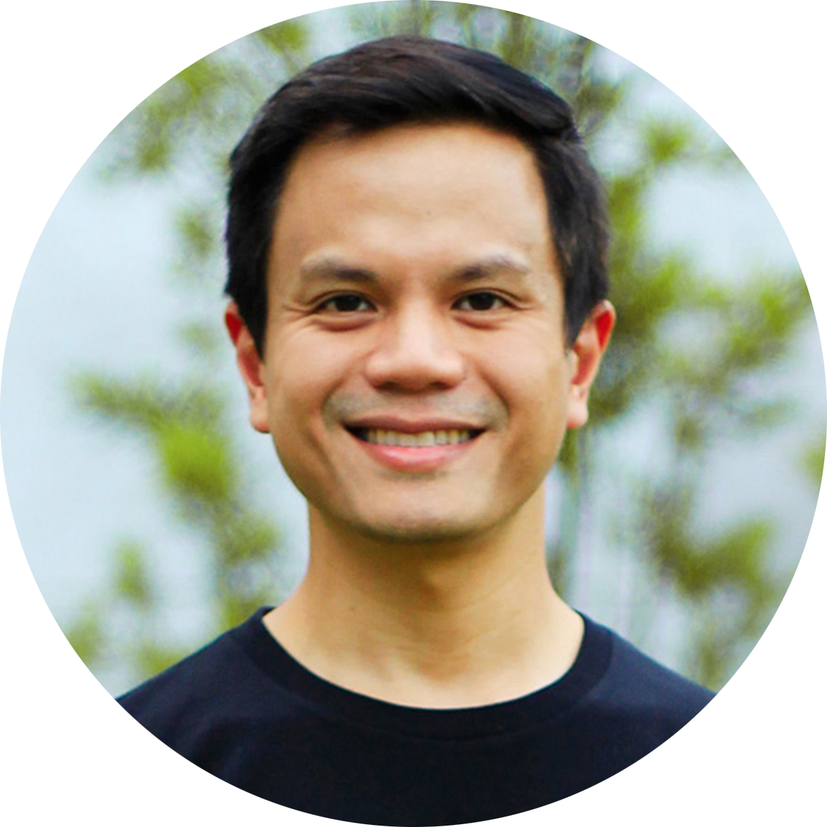

Slide 2
Andrew dela Serna
HAPPINESS ENGINEER
@druesome

Slide 3
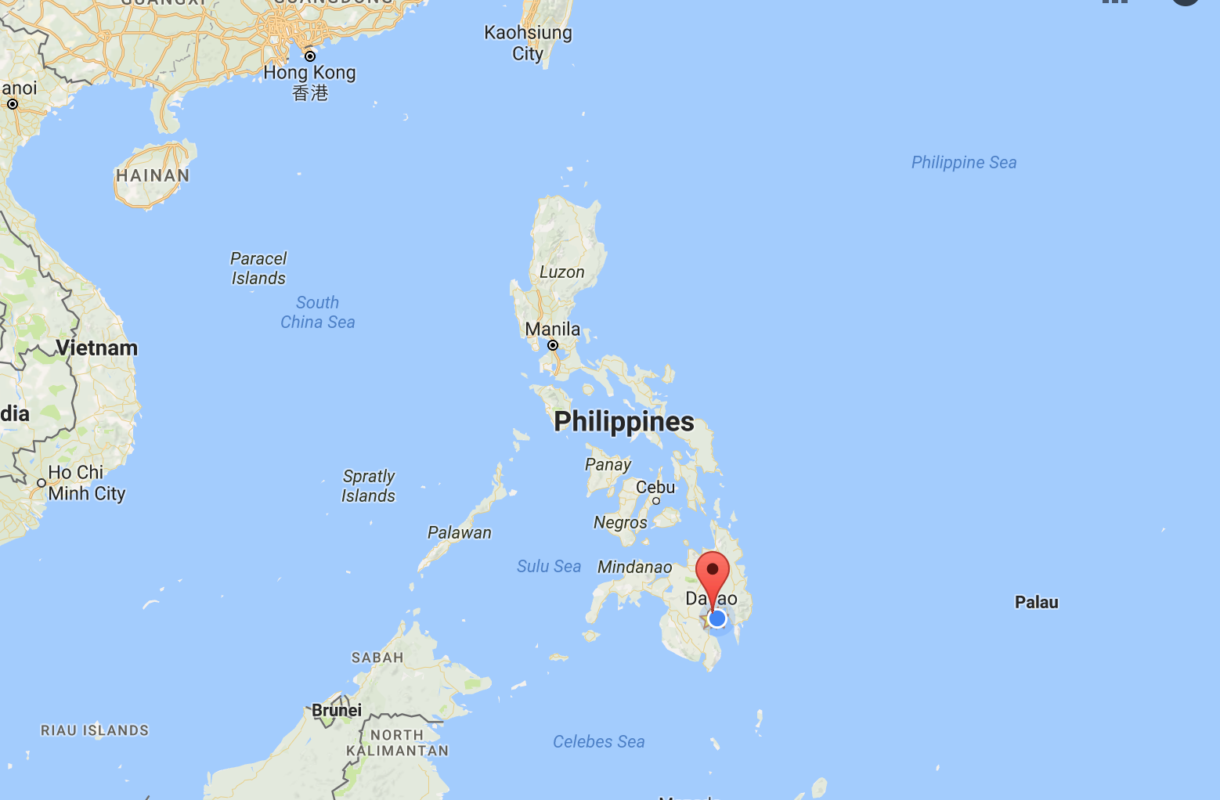

Slide 4
How We Work

Slide 5
Notes:
Automattic is the company behind WordPress.com
Also support other services
Founded by Matt Mullenweg in 2005.

Slide 6
How it all began
WordPress was created by Matt Mullenweg in 2003.
WordPress is a content management system that currently powers 26% of the web.
WordPress.com was created in 2005 to bring WordPress to the masses.
Photo credit: Florian Ziegler

Slide 7
Office? What office?
We are a distributed workforce of 514 Automatticians, spread across 52 countries, speaking more than 60 languages.

Slide 8
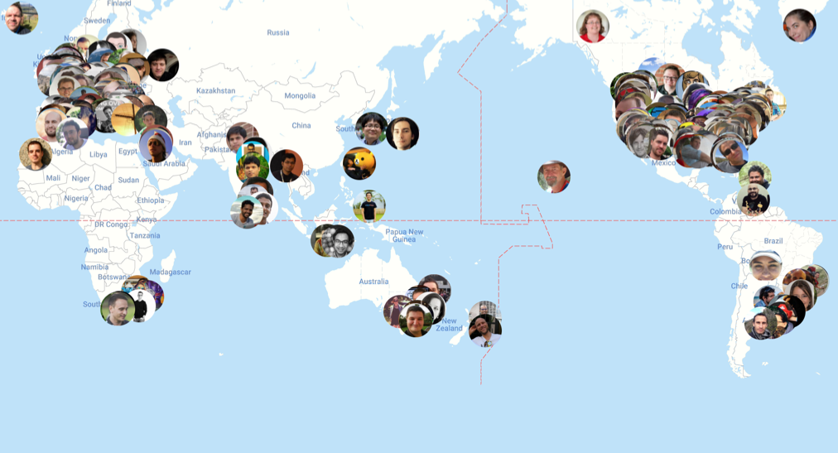
Notes:
Briefly introduce the group is attendance, coming from eight countries, etc...

Slide 9
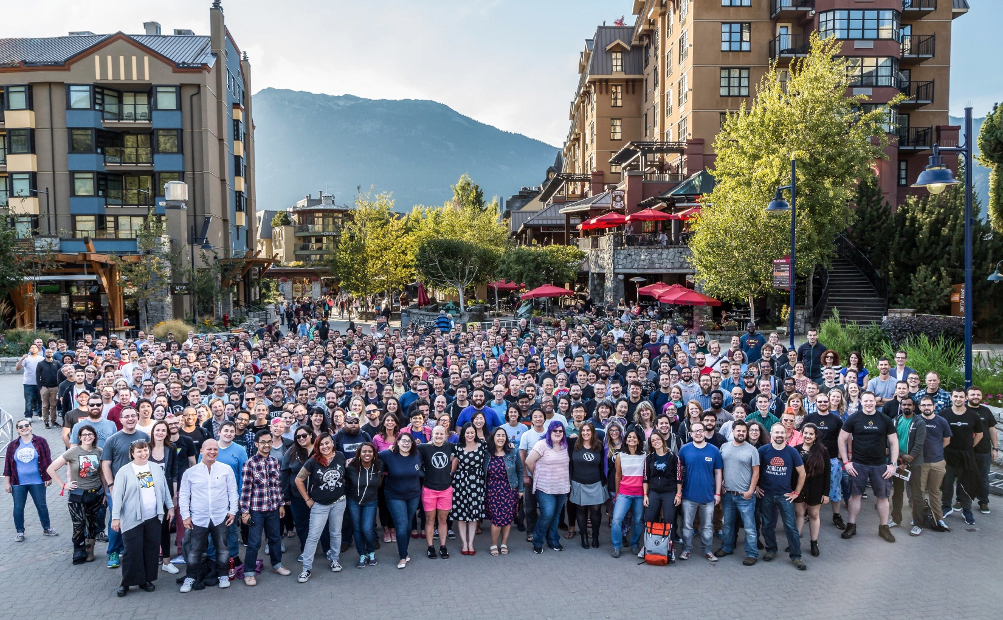

Slide 10
What is distributed?

Slide 11
Flexibility of
where and when to work

Slide 12
Office? What office?
We are a distributed workforce of 514 Automatticians, spread across 52 countries, speaking more than 60 languages.
We all work from our homes, or if not, in a cafe or coworking space or at a beach.

Slide 13
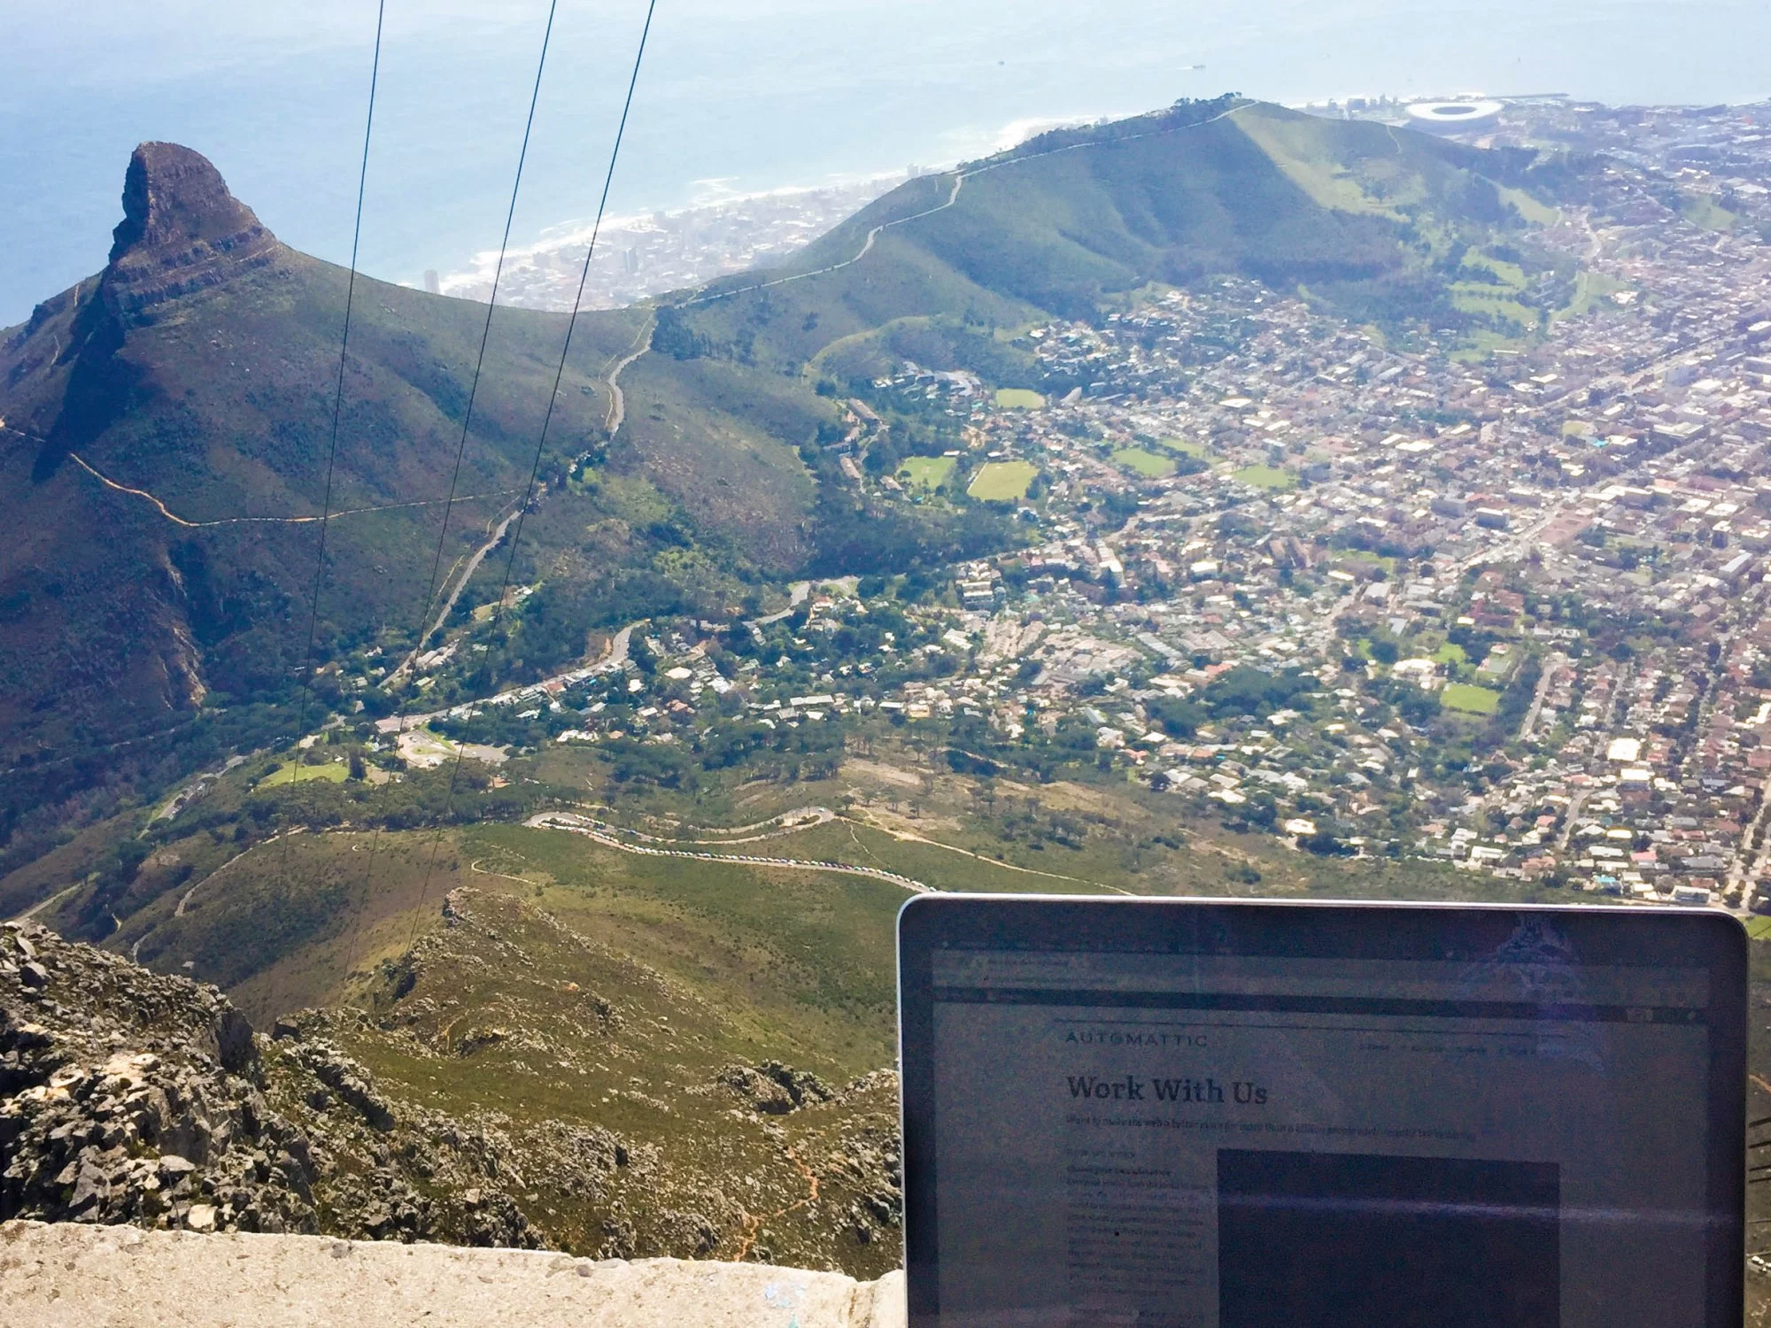
officetoday.wordpress.com
officetoday.wordpress.com
officetoday.wordpress.com
TABLE MOUNTAIN, SOUTH AFRICA
TABLE MOUNTAIN, SOUTH AFRICA

Slide 14
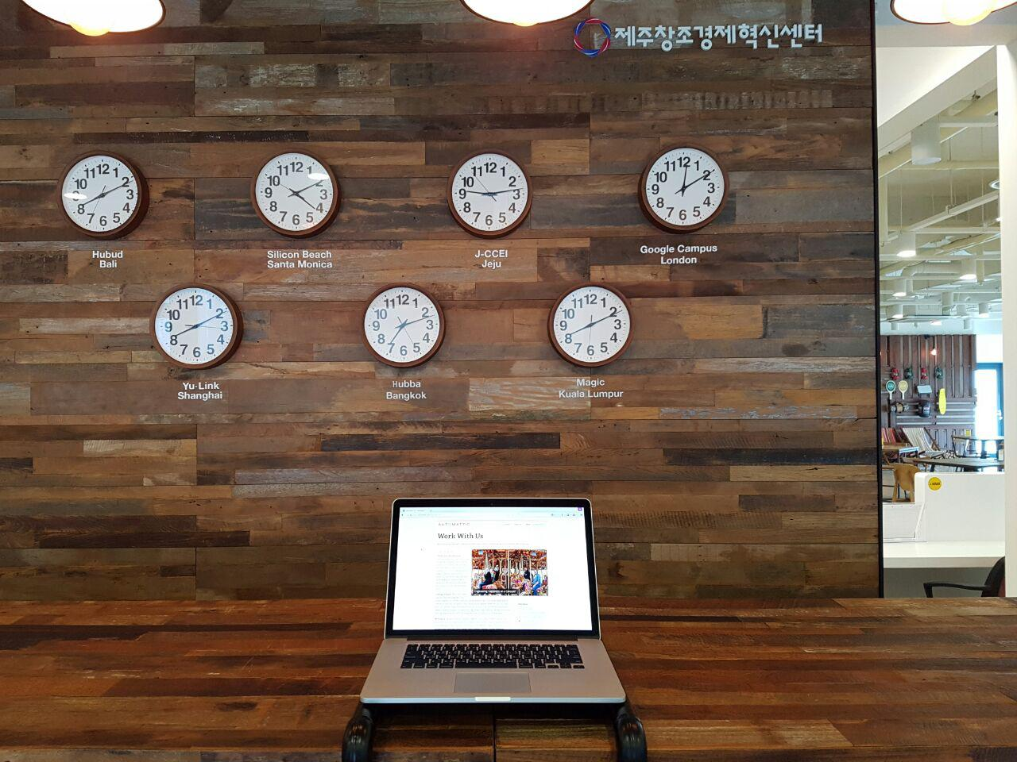
officetoday.wordpress.com
JEJU ISLAND, SOUTH KOREA

Slide 15
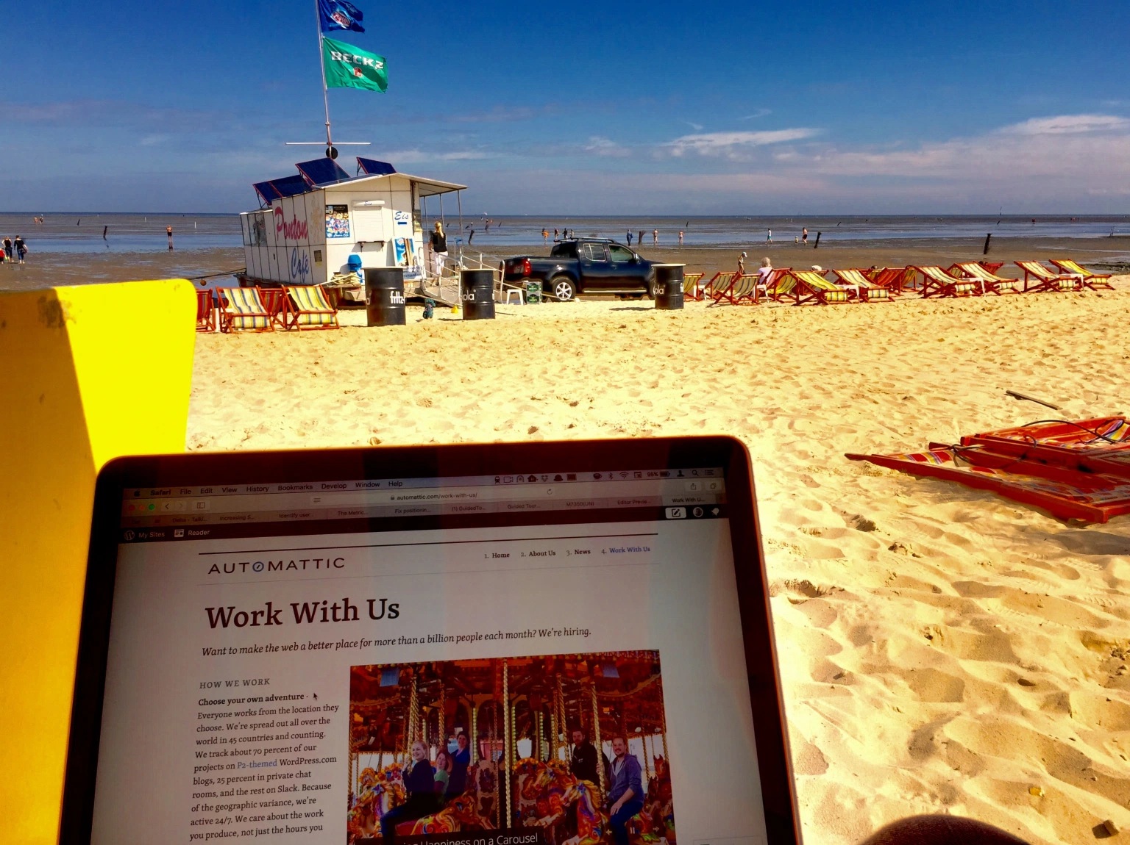
officetoday.wordpress.com
DUHNEN, GERMANY

Slide 16
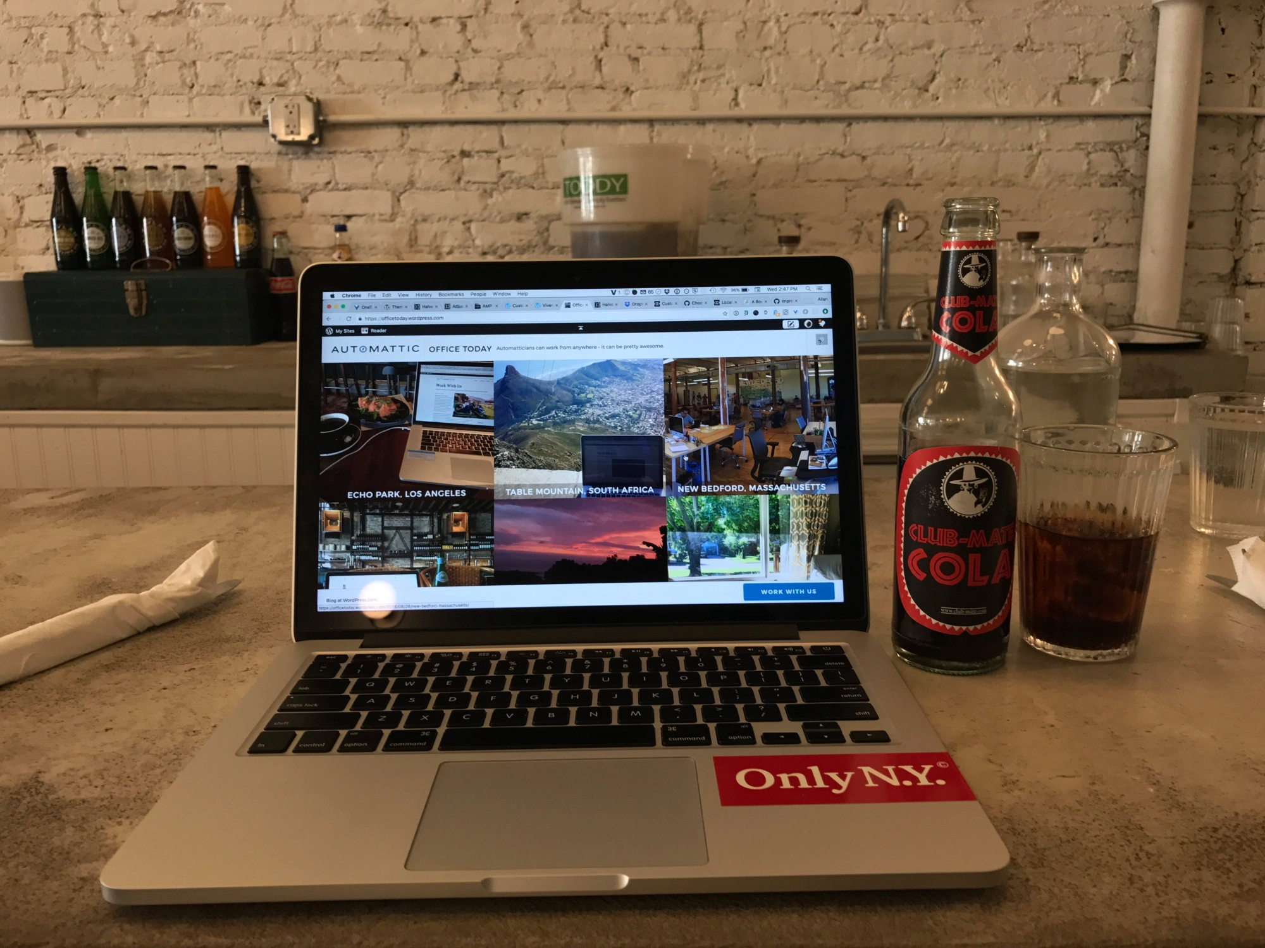
officetoday.wordpress.com
BROOKLYN, NEW YORK

Slide 17
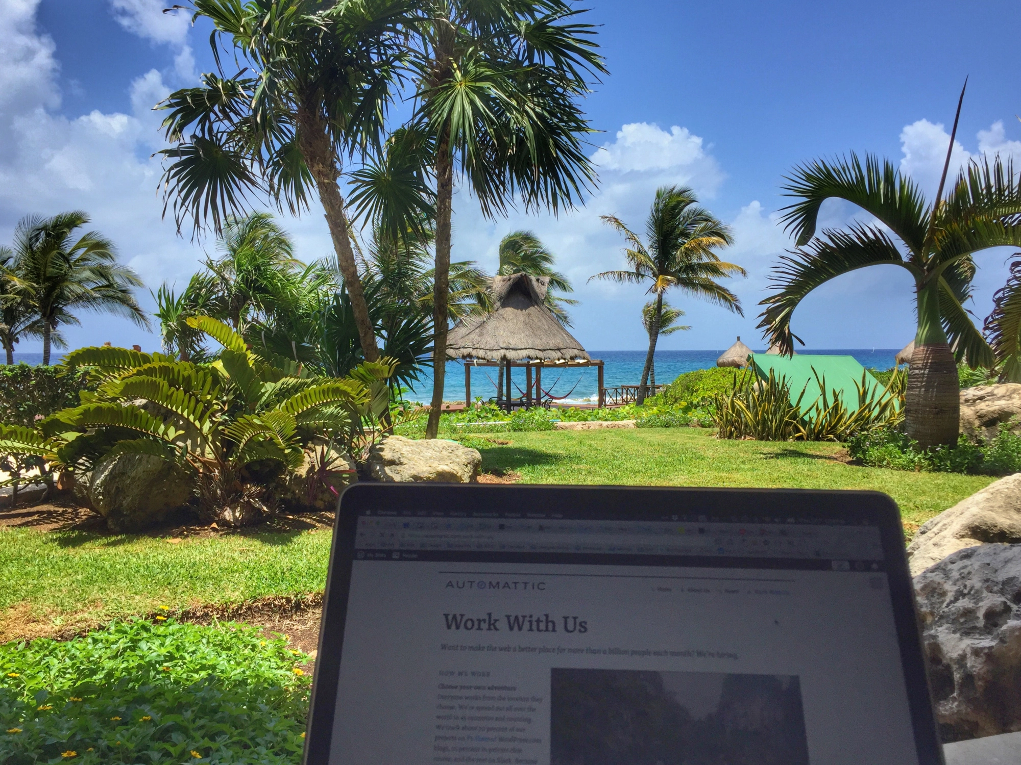
officetoday.wordpress.com
PUERTO ADVENTURAS, MEXICO

Slide 18
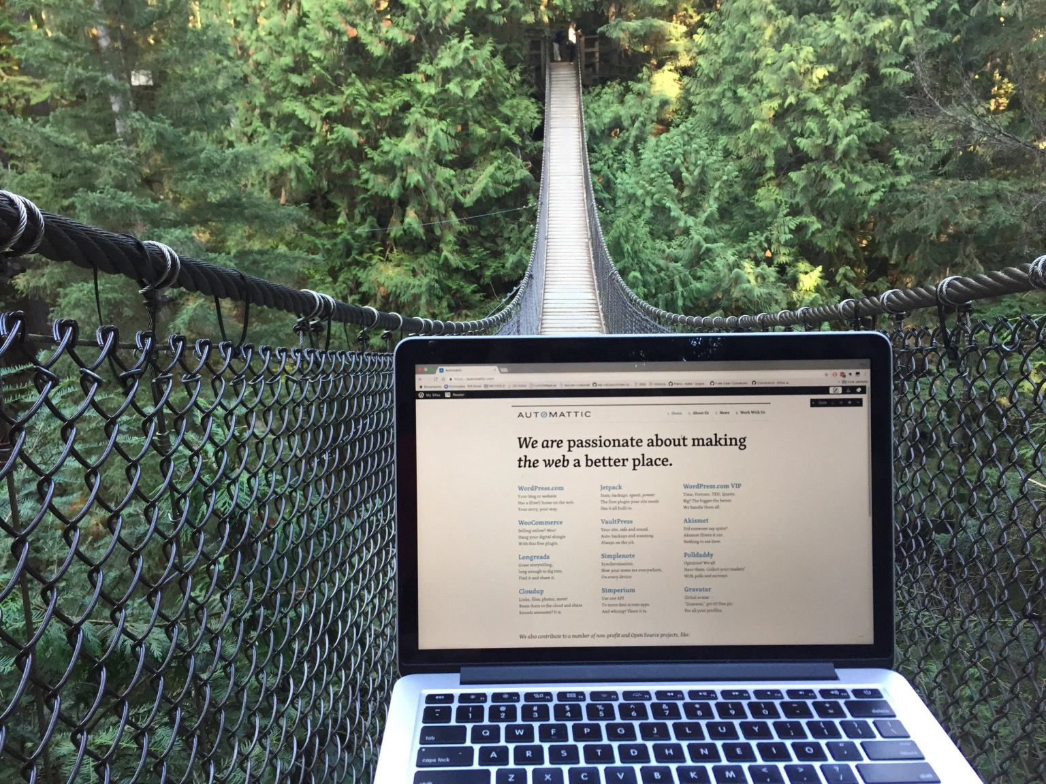
officetoday.wordpress.com
LYNN CANYON, VANCOUVER, CANADA

Slide 19
Office? What office?
We are a distributed workforce of 514 Automatticians, spread across 52 countries, speaking more than 60 languages.
We all work from our homes, or if not, in a cafe or coworking space or at a beach.
We have a brick and mortar office on 132 Hawthorne Street, San Francisco that is mainly used for conferences.

Slide 20
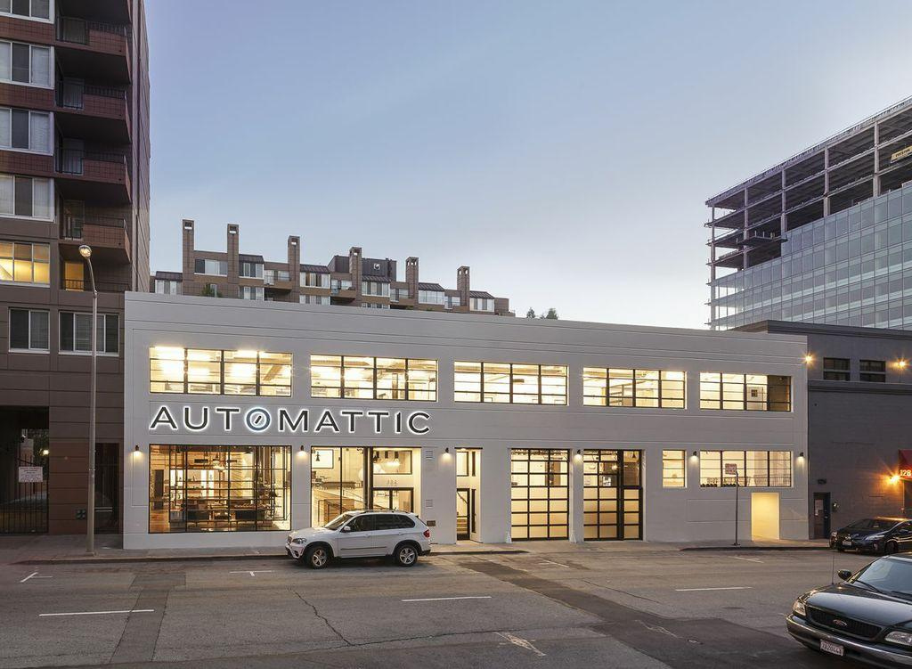
San Francisco, USA

Slide 21
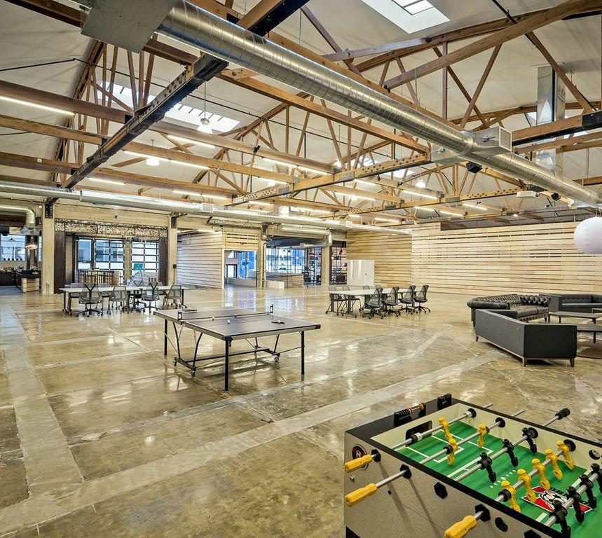
San Francisco, USA

Slide 22
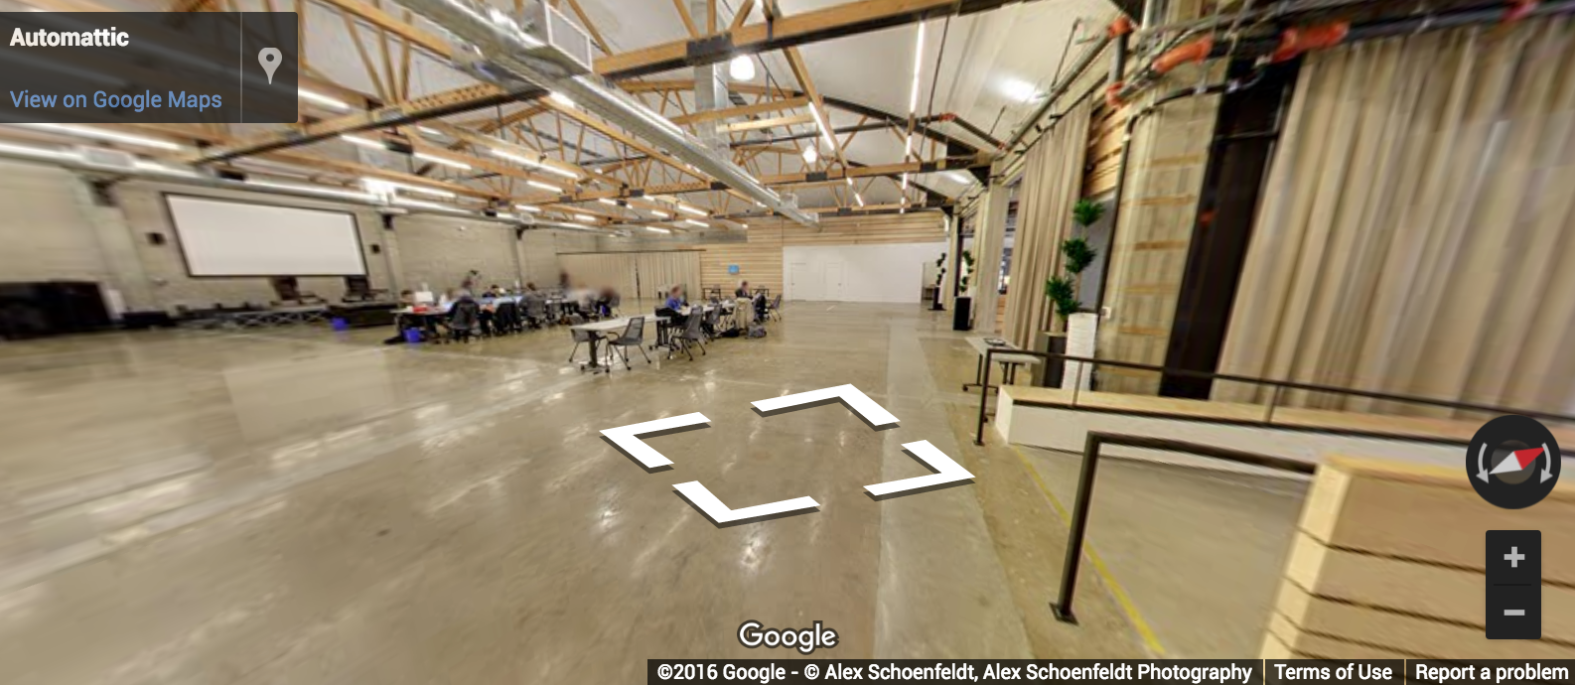
15,000 square feet
Used for conferences, networking events, learning opportunities, panel discussions, and professional development within the tech industry
For more info, visit lounge.automattic.com

Slide 23
Happiness

Slide 24
Role of a Happiness Engineer
Talk directly to users
Users can reach us via Live Chat
We can also be reached via email at help@wordpress.com or through our website’s contact form
Report bugs & payment disputes
Report bugs or errors in themes, UI, functionality directly to developers and make sure they are solved
Report payment disputes and issue refunds
Document
See to it that user-facing support pages are up-to-date
Everyone starts as a Happiness Engineer
Notes:
Spittle’s comment:
I'd add some nuance to the "flat" aspect of our organization. A lot of people will hear "Flat Organization" and think that we don't have any leads, leadership teams, etc. What we have is what I like to think of as a "Flat" Organization.
That is, we're not flat on our org chart. There are leadership positions and HEs report to their team lead who reports to me and I report to Matt. So there's a structure there.
But we are flat in our decision making. That piece is something I think would resonate with the regional audience. Our team leads aren't looking over your shoulder. They're not telling you what decisions to make. And you don't need their approval for things like refunds and special exceptions to customers.
Servant leader: it’s not a manager position where we’re there to control, or tell HEs what need to be done. Team leads are there to literally “serve” the team, and help them.

Slide 25
Communication

Slide 26
“Communication is Oxygen”
Automattic’s Creed:
I will never stop learning. I won’t just work on things that are assigned to me. I know there’s no such thing as a status quo. I will build our business sustainably through passionate and loyal customers. I will never pass up an opportunity to help out a colleague, and I’ll remember the days before I knew everything. I am more motivated by impact than money, and I know that Open Source is one of the most powerful ideas of our generation. I will communicate as much as possible, because it’s the oxygen of a distributed company. I am in a marathon, not a sprint, and no matter how far away the goal is, the only way to get there is by putting one foot in front of another every day. Given time, there is no problem that’s insurmountable

Slide 27
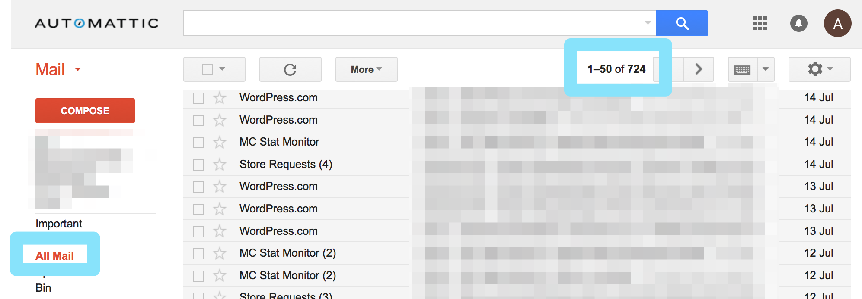
No Email

Slide 28
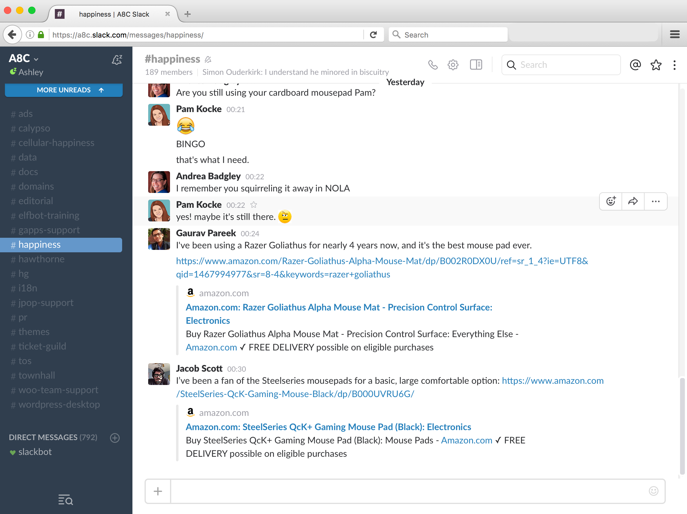
Daily interactions

Slide 29
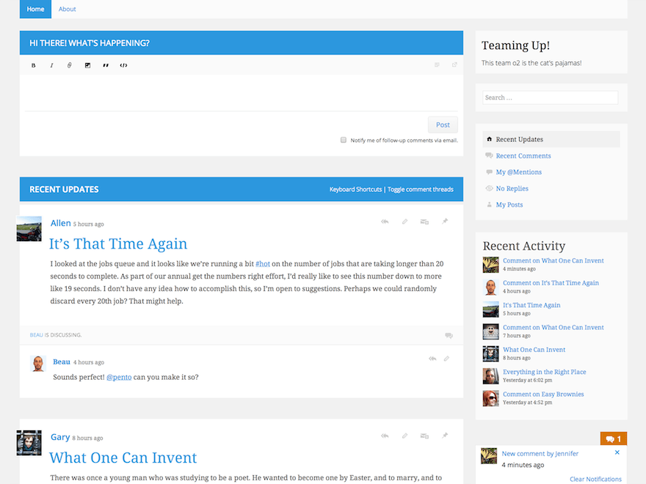
P2 it, or it didn’t happen!

Slide 30
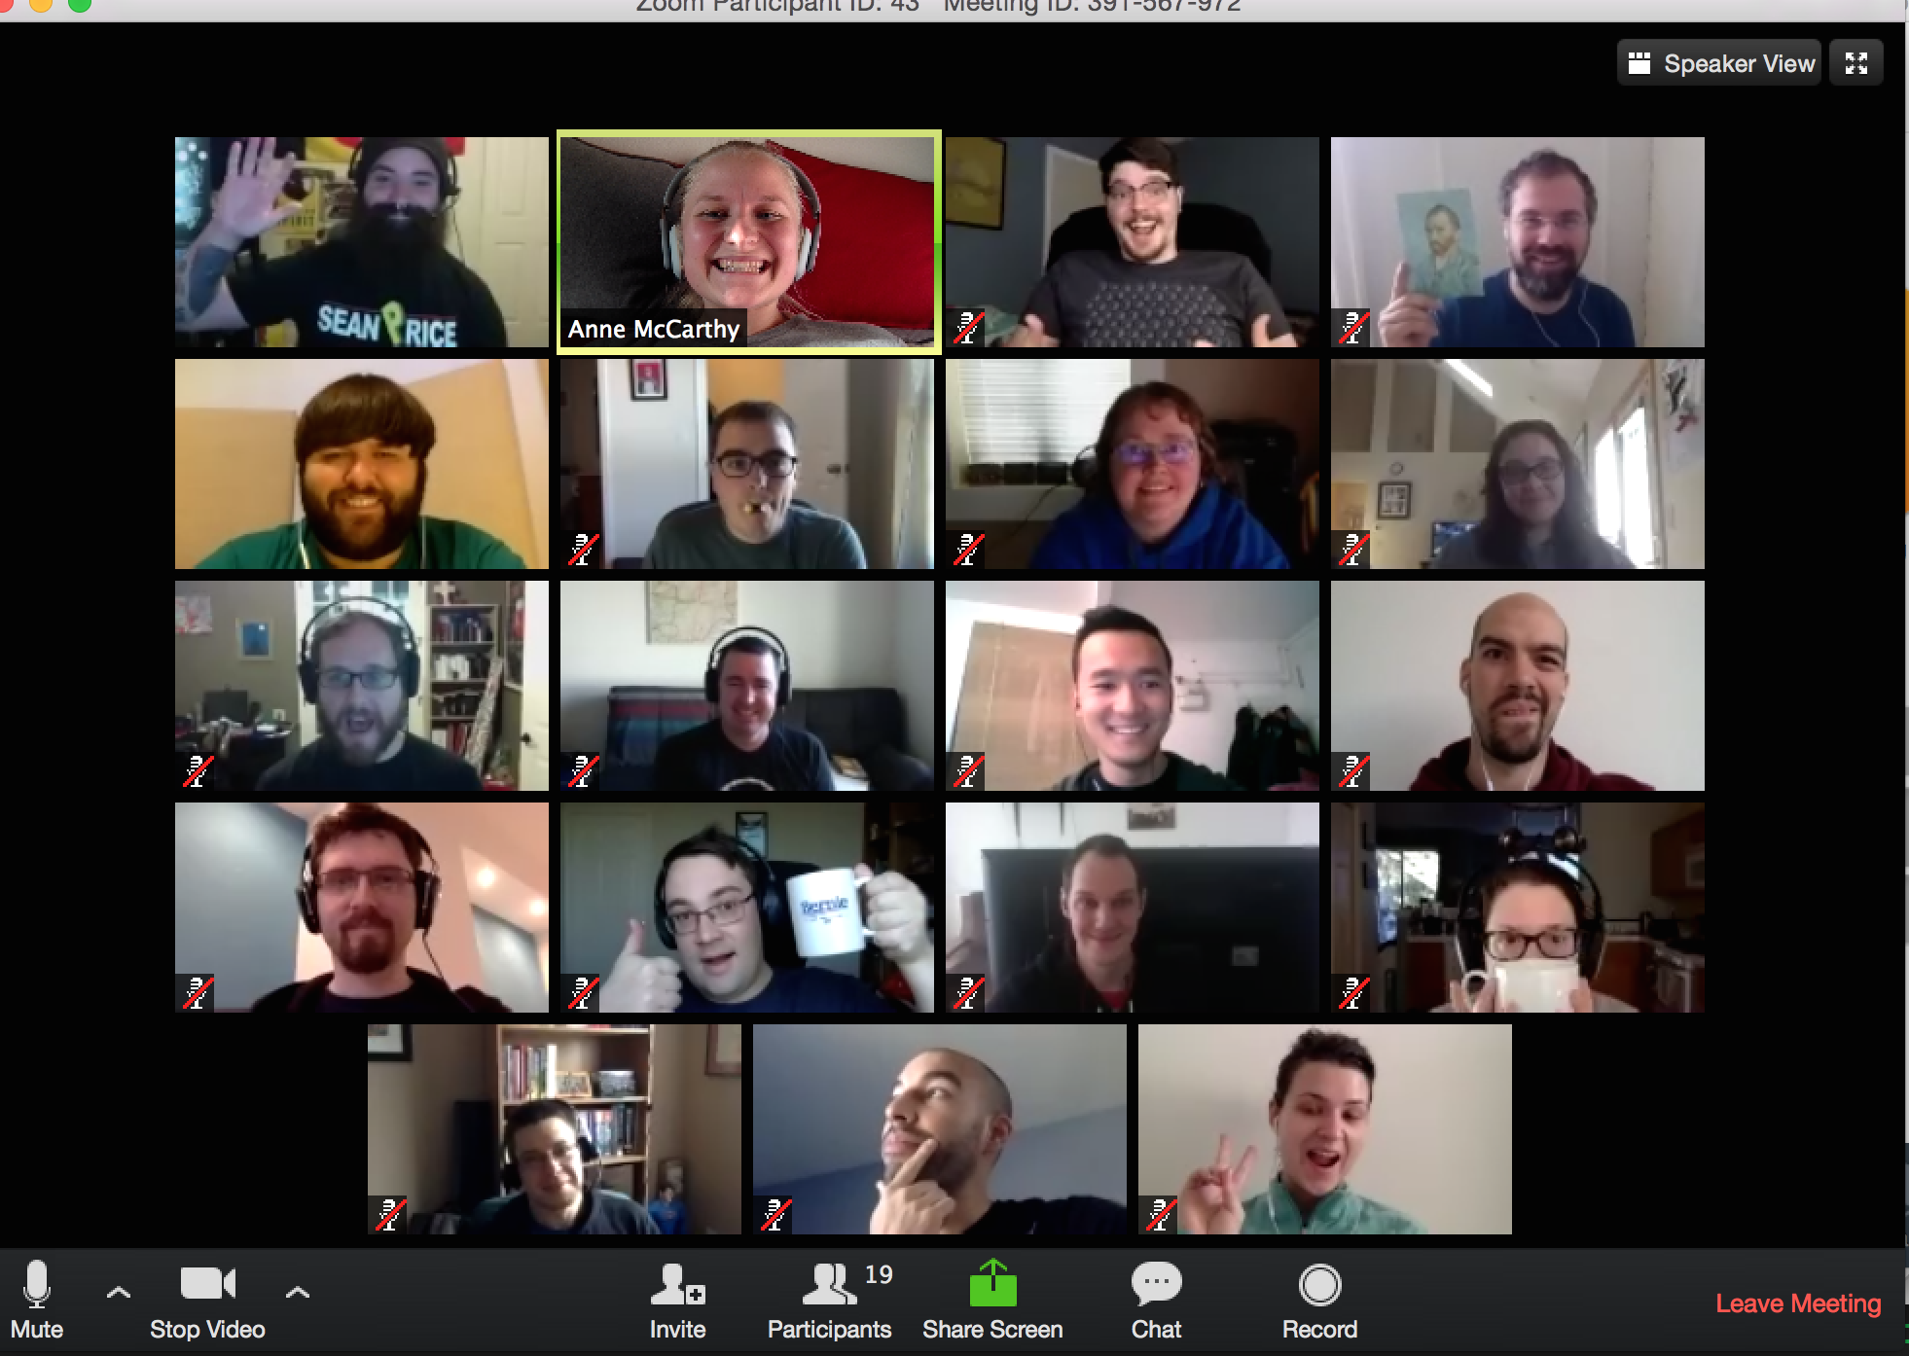
Hangouts with

Slide 31
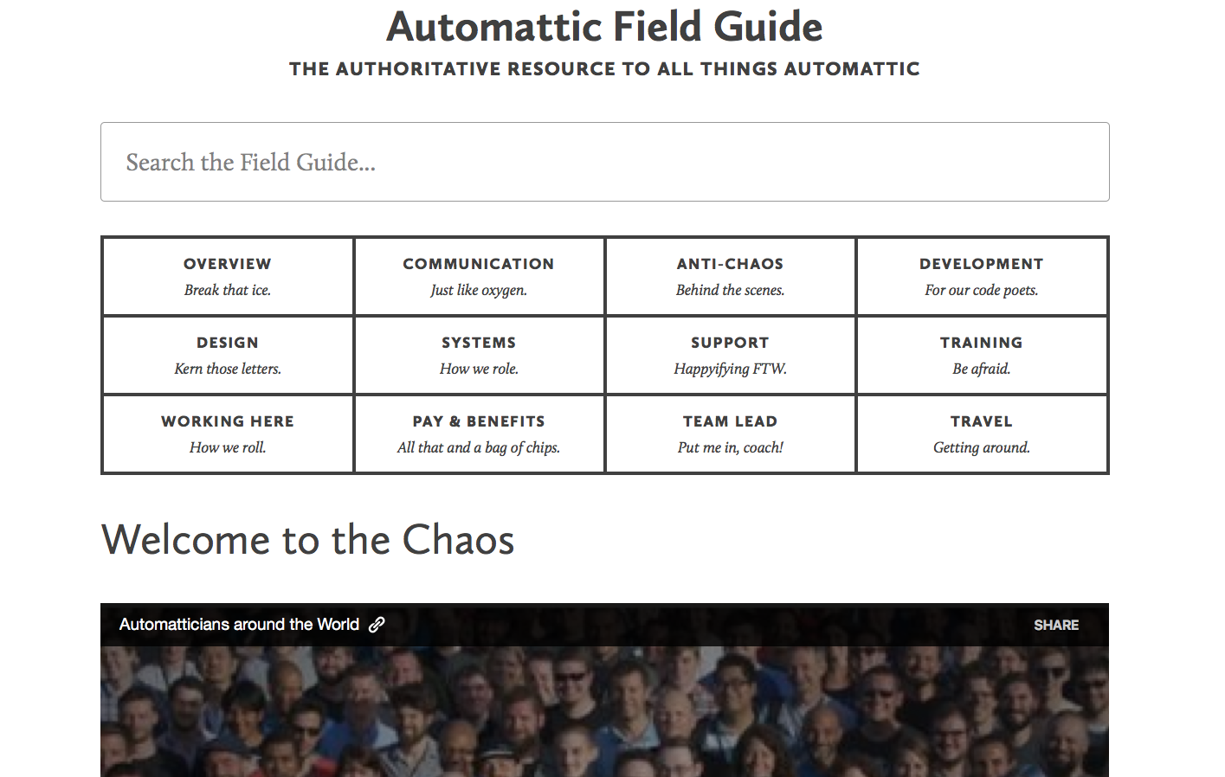
Document everything!
Remove silos

Slide 32
Perks of the Job

Slide 33
Perks of the Job
Travel, travel, travel!

Slide 34
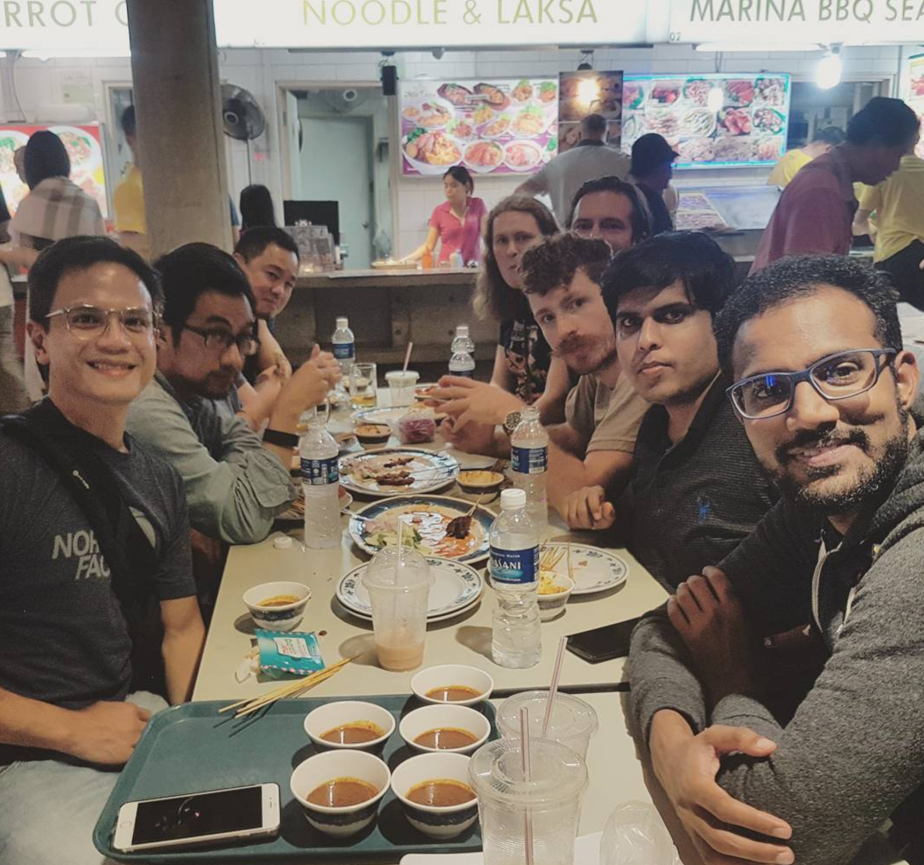

Slide 35
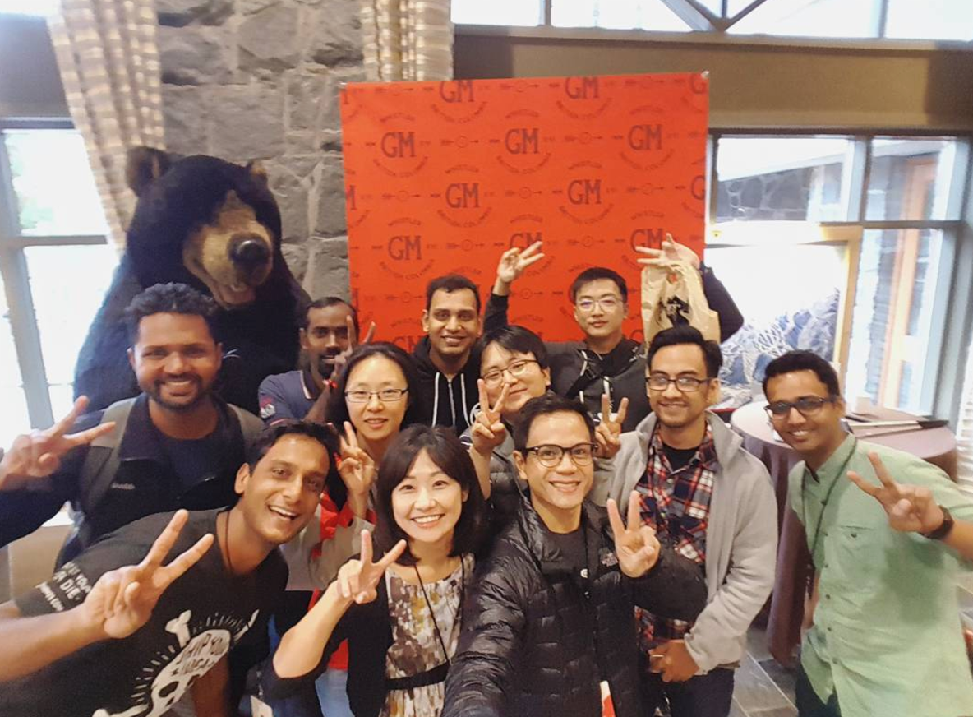

Slide 36
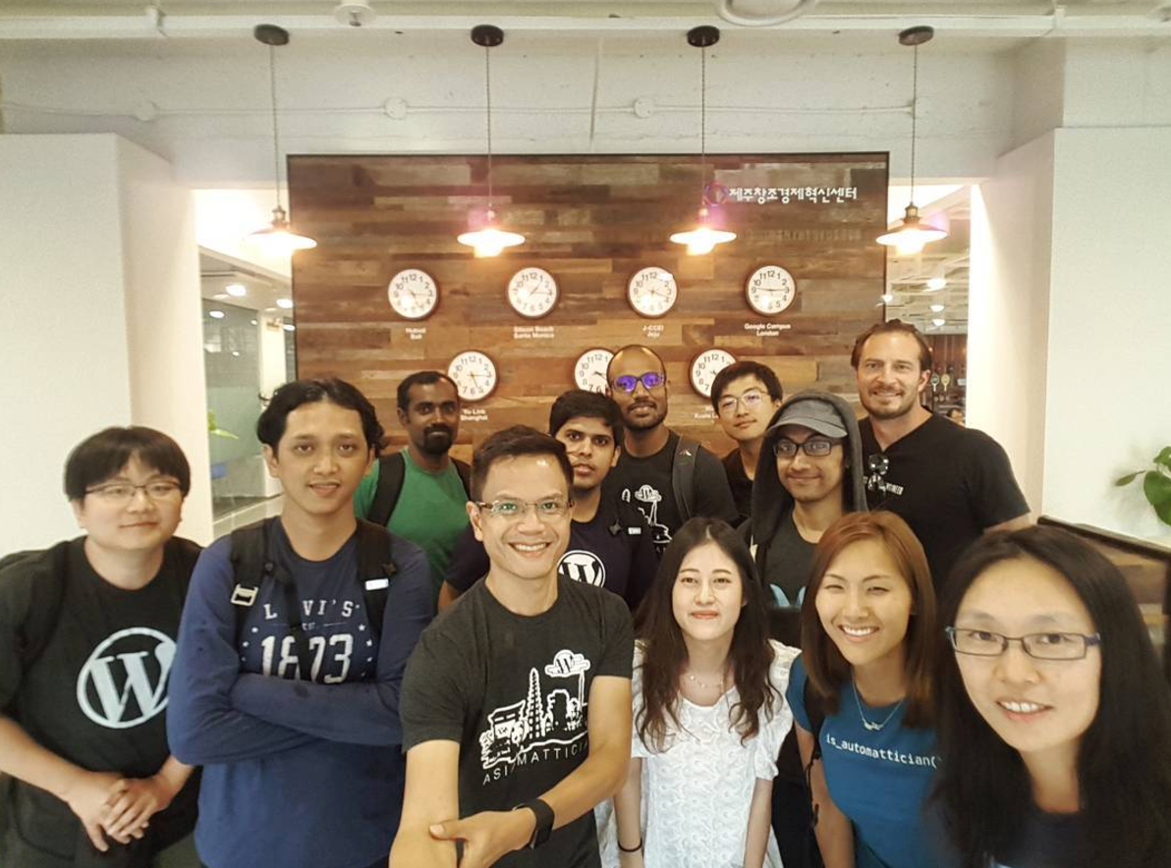

Slide 37
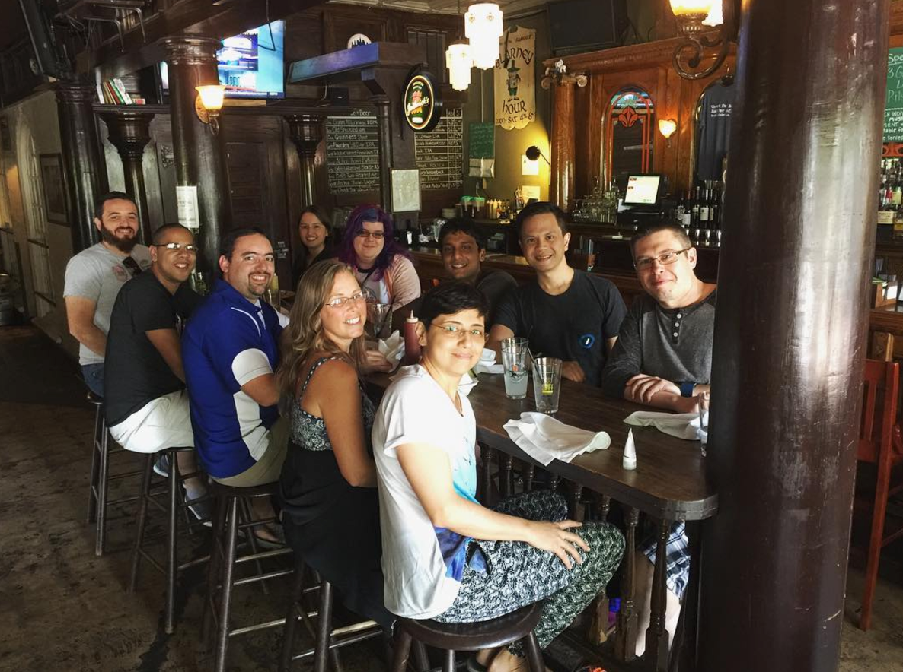

Slide 38
Perks of the Job
Travel, travel, travel!
Office Setup

Slide 41
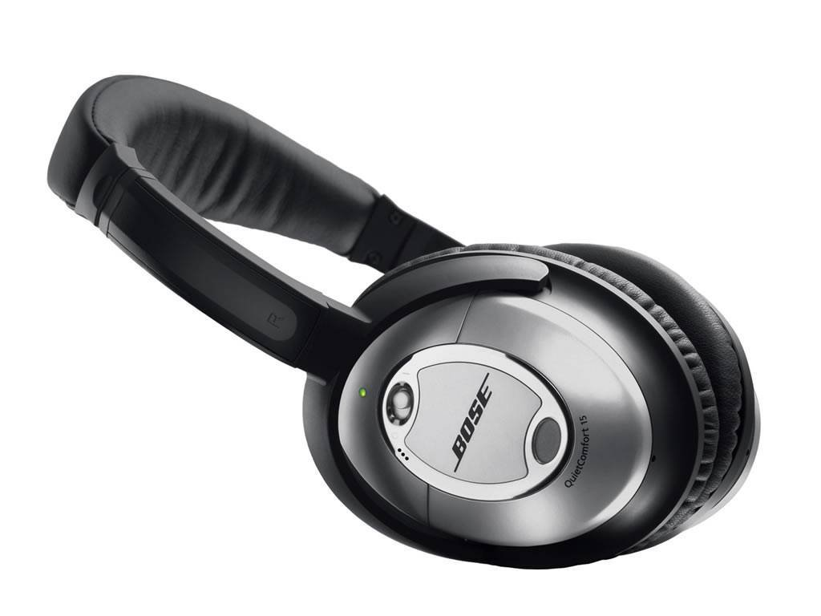

Slide 43
Perks of the Job
Travel, travel, travel!
Office Setup
Flexible Vacations

Slide 45
Happier Employee

Slide 46
Geography

Slide 47
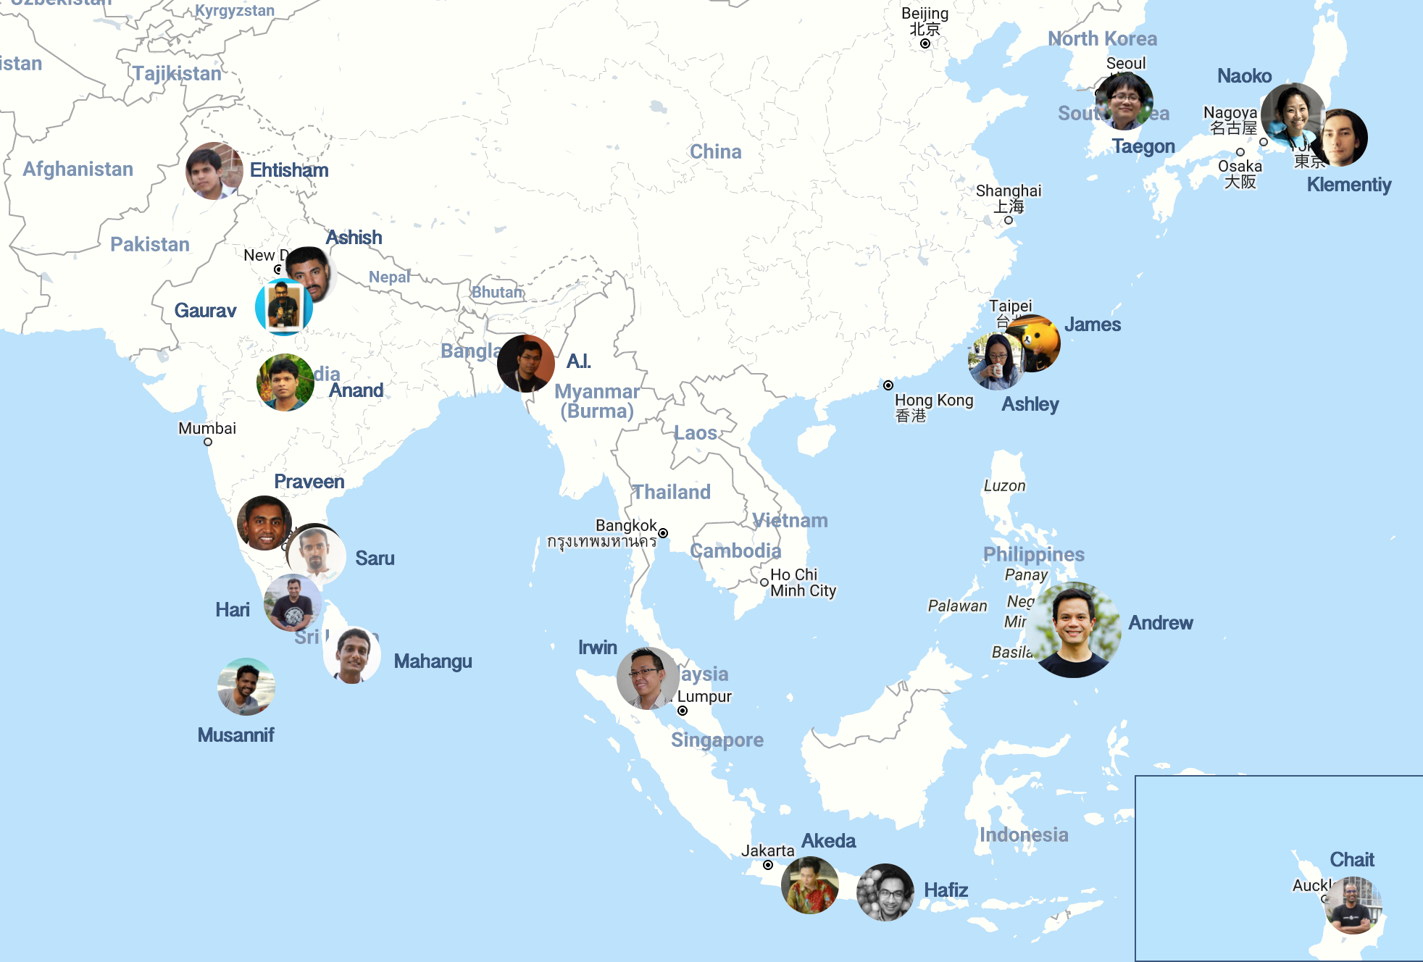
Notes:
Briefly introduce the group is attendance, coming from eight countries, etc...

Slide 49
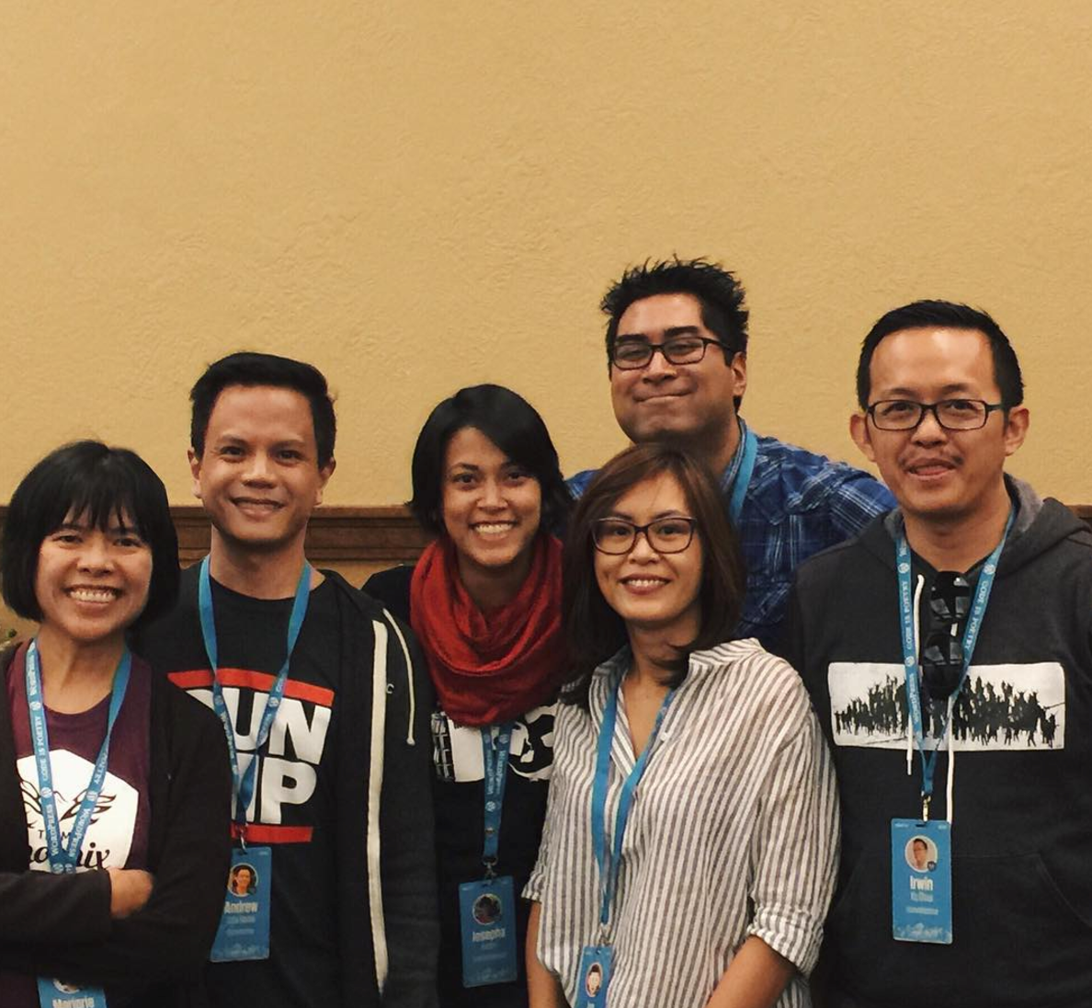

Slide 50
We’re hiring!
Happiness Engineers
Woo Happiness Engineers
Theme Wranglers
Code Wranglers
Mobile Developers
VIP Wranglers
and many, many more...

Slide 51
We’re hiring!
automattic.com/work-with-us

Slide 52
Thank you!

